Slide 1

CX Journey Management Overview
2020 Fall WTWY
Annual Gala
Proposal to Drive Reach & Awareness
WTWY International
Notes:
Ganesh

Slide 2
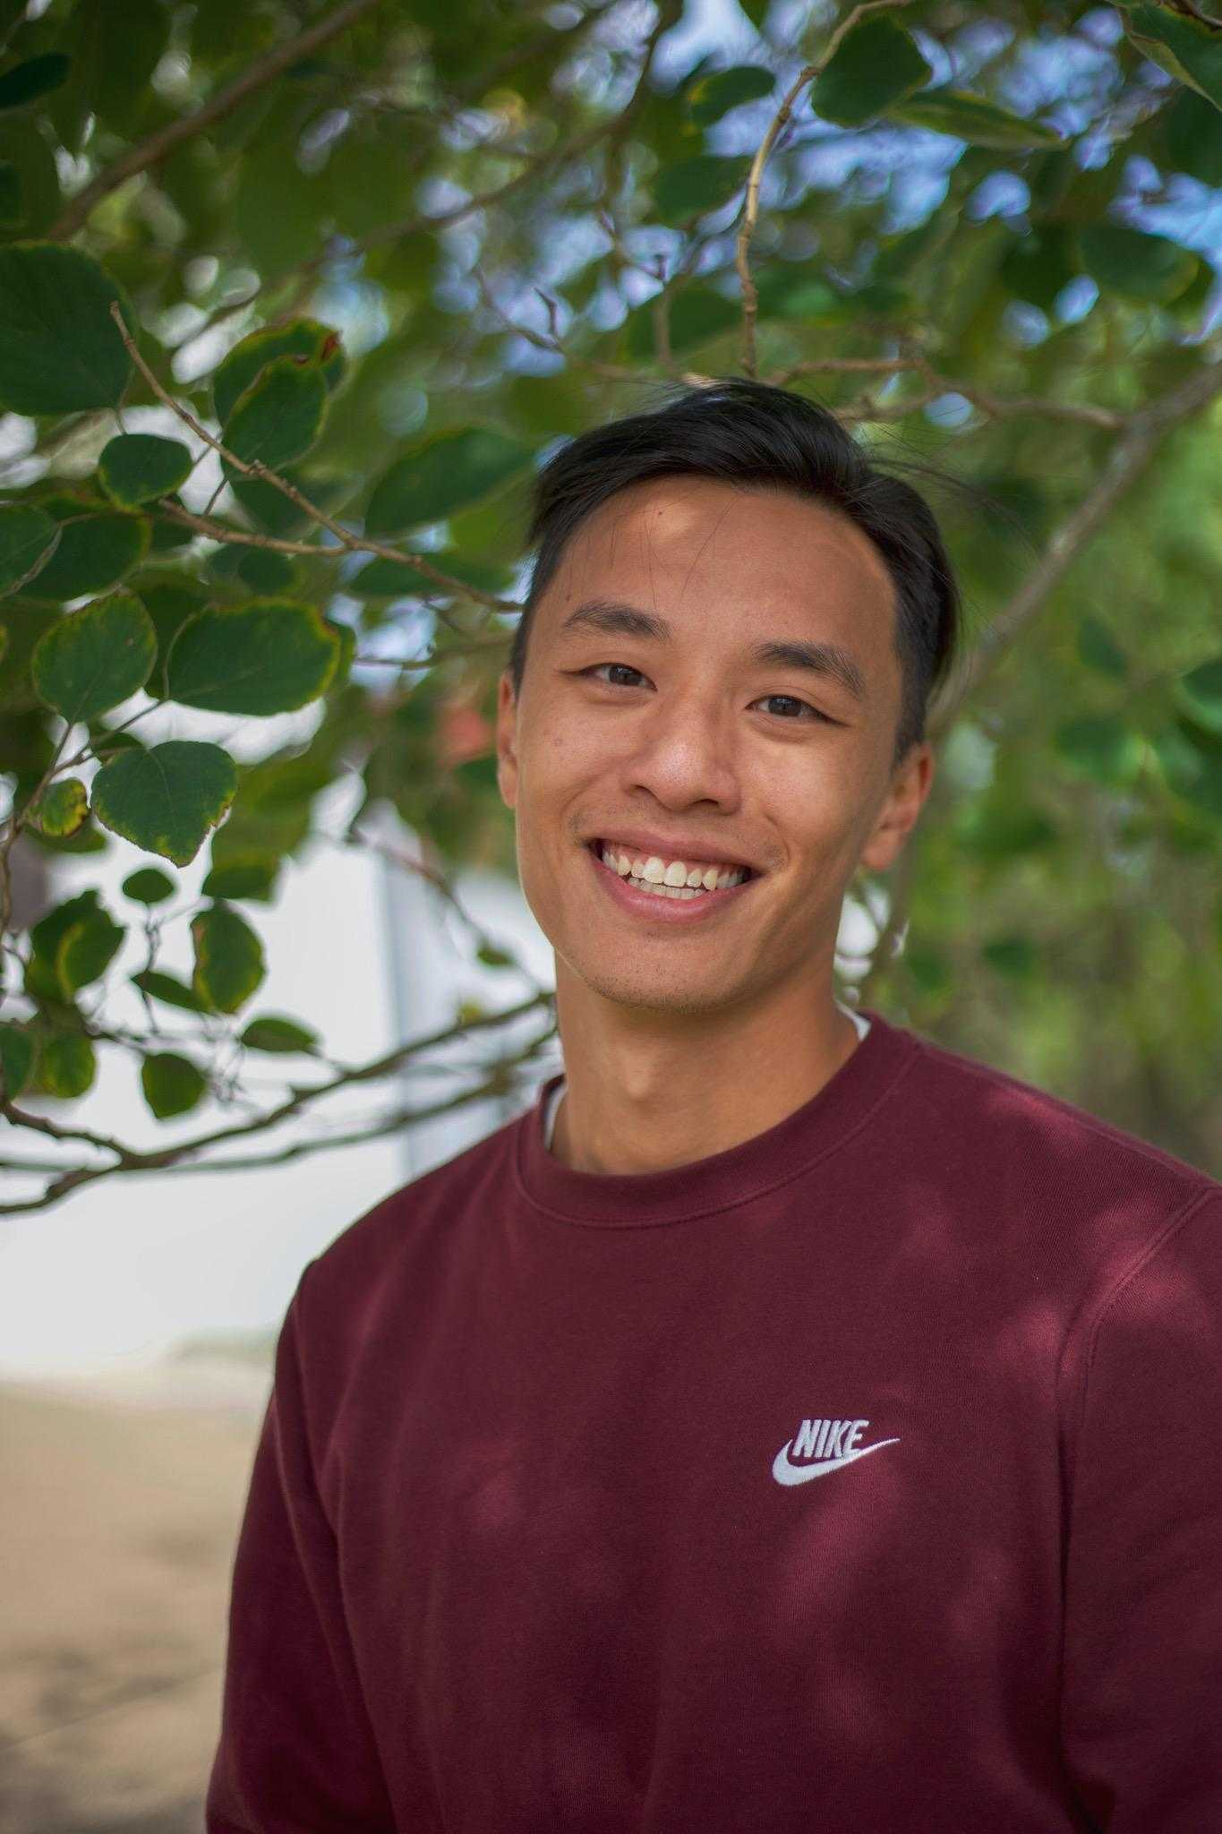
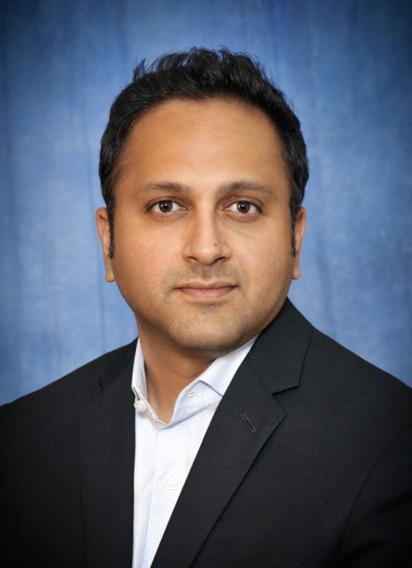
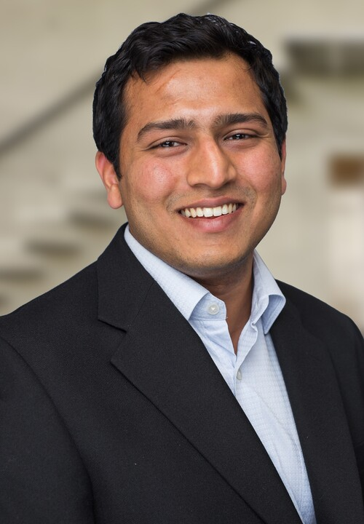
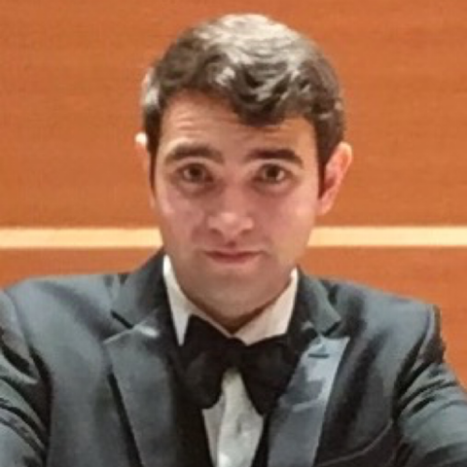
PROJECT TEAM
Andrew Auyeung
Ganesh Bala
Navish Agarwal
Zachary Brandt
2020 WomenTechWomenYes (WTWY) Annual Gala, NYC
Notes:
Ganesh
Introductory sound-bite. Hi Everyone! At the outset, on our team’s behalf, let me express our thanks to the WTWY for an opportunity to partner with you on this endeavor. We believe Diversity in the technical workforce at all levels enhances collective intelligence and innovation. So, we are really excited about the possibilities and how we help you accelerate progress on your mission.
Without further adieu, let me briefly introduce you our team members.
Andrew
Navish
Zach
Educator, Music, Manufacturing, Customer Strategy

Slide 3
AGENDA
Executive Summary
New York City MTA Overview
Scope, Data & Assumptions
Analysis & Proof Points
Conclusion & Future Steps
2020 WomenTechWomenYes (WTWY) Annual Gala, NYC
Notes:
(Ganesh)

Slide 4


EXECUTIVE SUMMARY
7 Subway locations recommended to drive awareness & increase signups
INSIGHT
Low volatility in the top rankings in terms of MTA commuter traffic, despite the Pandemic
Manhattan stations below Central Park index highly, both in traffic and qualified opportunity
Focused deployment strategy will optimize composition of street teams & maximize reach
RECOMMENDATION
Focus on 7 stations - 34th St.-Penn, 34th St.-Herald Square, Grand Central-42nd St., 14th St-Union Square, 42nd St.-Port Authority, 23rd St., Fulton St
Optimal to engage target audience during evening commute hours
Additional options exist based on staffing capacity
2020 WomenTechWomenYes (WTWY) Annual Gala, NYC
Notes:
(Navish)
Focused deployment strategy focused on Manhattan cluster will maximize reach and allow for the opportunity to be optimize composition of street teams
OPPORTUNITY
We see a real opportunity to increase awareness/reach among the target audience of technology professionals and drive sign-ups for the upcoming annual gala by strategically deploying smaller teams to 10 stations in the city to reach over 60% of the targets

Slide 5
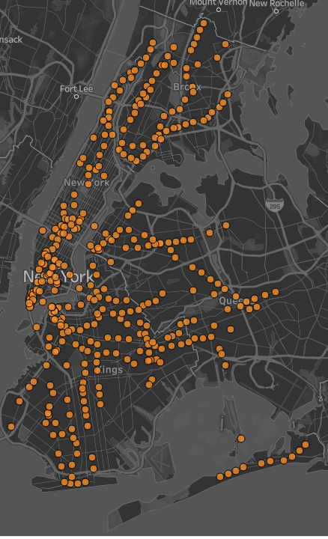
New York City MTA : Key Stats
Avg Riders / Day
Includes daily commuters and visitors to NYC
2.3M+
Stations
Oldest and largest public transportation system
379
Serving 4 boroughs
Manhattan, Queens, Brooklyn, and the Bronx
4
2020 WomenTechWomenYes (WTWY) Annual Gala, NYC
Notes:
(Navish)
Largest in the world (in terms of number of stations)

Slide 6
SCOPE, DATA & ASSUMPTIONS
SCOPE
DATA SOURCES
ASSUMPTIONS
Gather insights on average daily commuter traffic on the MTA network
Identify a small group of stations that drive a significant share of traffic
Recommend approach to maximize outreach in the lead-up to the Fall 2020 Gala
Discuss and document learnings that can be leveraged for future efforts
MTA Turnstile Data
MTA Subway Stations Geo Location Data
The Fall 2020 Gala is assumed to be an online event
Analysis to focus on key work-related commute hours.
KEY CONSIDERATIONS
¹ Source: http://web.mta.info/developers/turnstile.html (MTA Turnstile Data)
² Source: http://web.mta.info/developers/data/nyct/subway/Stations.csv (MTA Geo Data)
2020 WomenTechWomenYes (WTWY) Annual Gala, NYC
Notes:
(Navish)

Slide 7
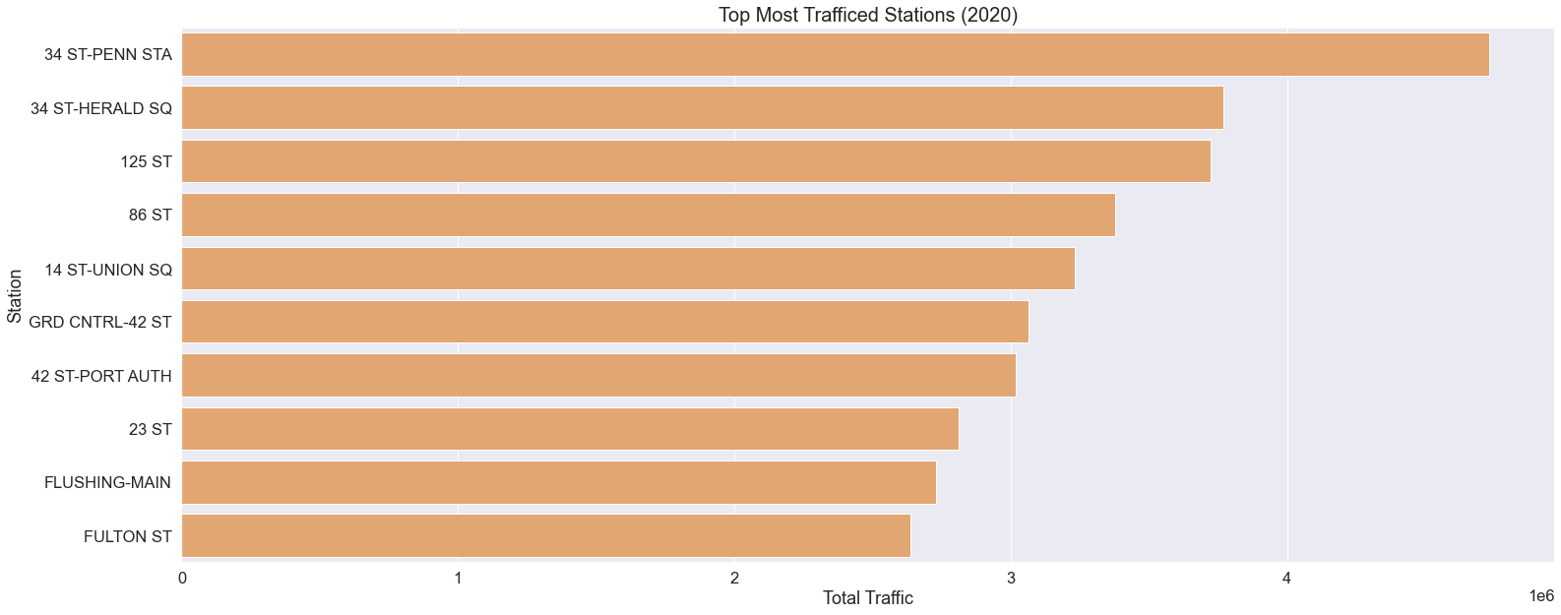
17% of commuter traffic is captured by Top 2% Stations
2020 WomenTechWomenYes (WTWY) Annual Gala, NYC
Notes:
Zach
17% of traffic covered by 2% of stations (10 out of 379 stations)
We grouped stations and added the total of entries and exists …

Slide 8
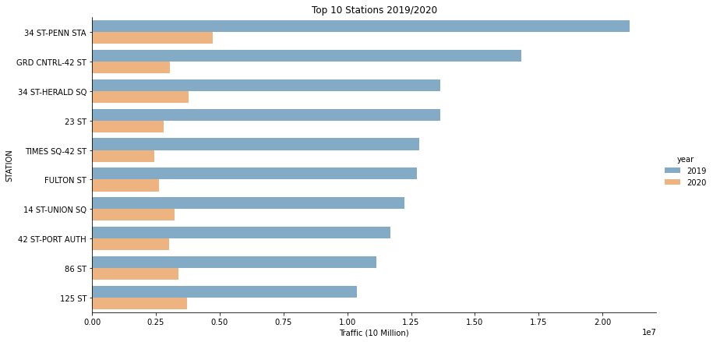
No significant change to rankings based on commuter traffic between 2019 and 2020
2020 WomenTechWomenYes (WTWY) Annual Gala, NYC
Notes:
Zach will own this slide and add speaker notes

Slide 9
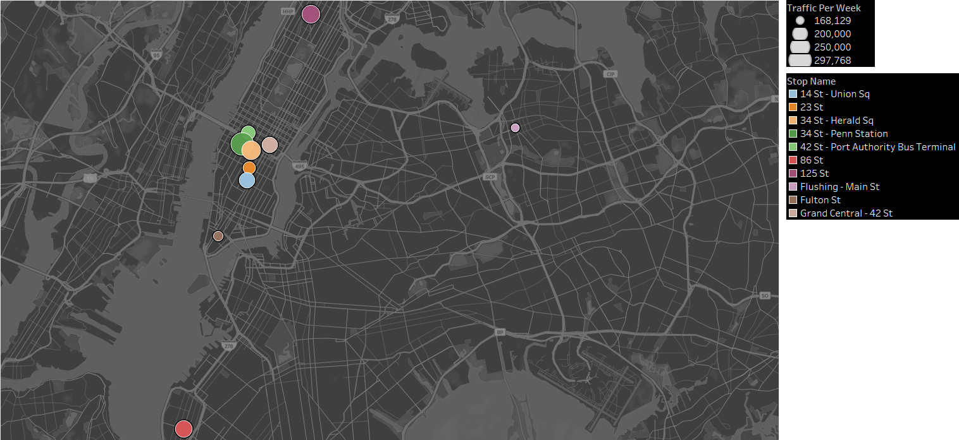
Majority of these stations are clustered around Manhattan, below Central Park
2020 WomenTechWomenYes (WTWY) Annual Gala, NYC
Notes:
(Zach)
Talking pts.:
Majority of the Hot-Spot stations are clustered around Manhattan, below Central Park
The remaining few Hot-Spot stations are spread across the other 3 boroughs
Our recommendations are based of our analysis of the Manhattan
-Some of them are clustered around transfer stations

Slide 10
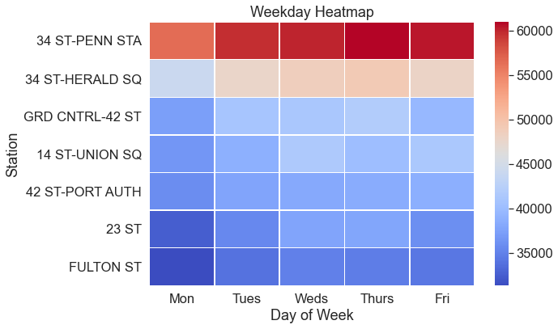
Daily traffic patterns at Key MTA stations
2020 WomenTechWomenYes (WTWY) Annual Gala, NYC
Notes:
(Andrew)
What percentage of traffic goes thru these 7 stations? What is the targetable audience based on some assumptions on traffic patterns during weekdays?
Analysis focused on weekday commuter traffic
Rationale for focusing on weekdays – data supported that the traffic volumes were substantially lower during weekends and further, it was assumed that weekdays were the best time to engage with the target audience (tech professionals)

Slide 11
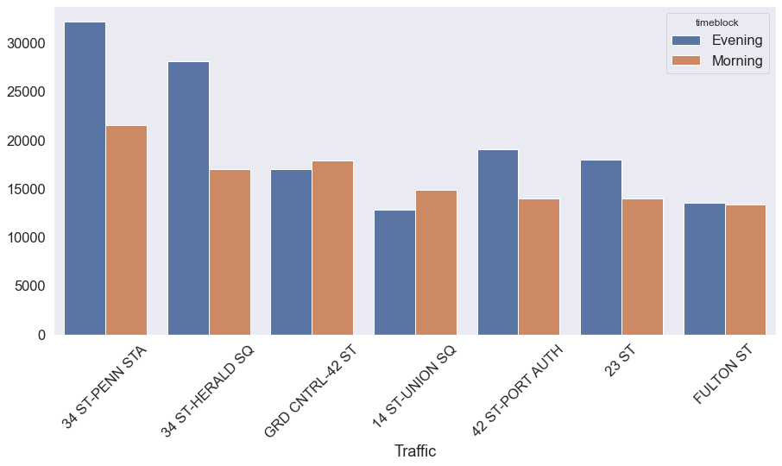
Focusing on evening commuter traffic hours will yield the best results
2020 WomenTechWomenYes (WTWY) Annual Gala, NYC
Notes:
(Andrew)
What percentage of traffic goes thru these 7 stations? What is the targetable audience based on some assumptions on traffic patterns during weekdays?
Which window did we use : 2 – 8hr windows ( 5am-1pm) and (1-8pm)

Slide 12
Focusing on evening commuter traffic hours will yield the best results
Thursday
Evening!
2020 WomenTechWomenYes (WTWY) Annual Gala, NYC
Notes:
(Andrew)
What percentage of traffic goes thru these 7 stations? What is the targetable audience based on some assumptions on traffic patterns during weekdays?
Which window did we use : 2 – 8hr windows ( 5am-1pm) and (1-8pm)

Slide 13
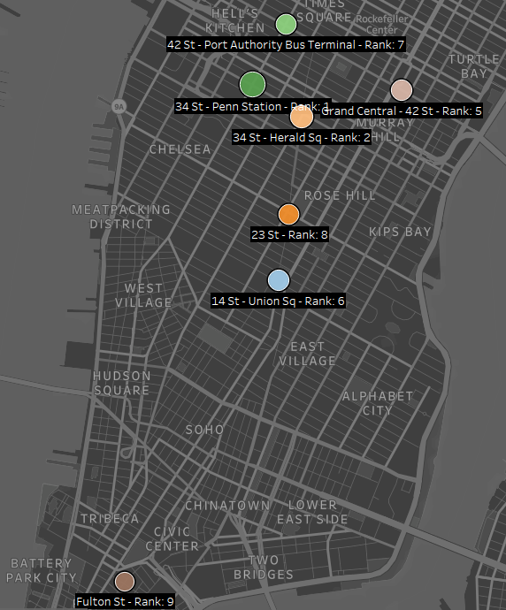


Recommendation & Opportunities for the future
Where
7 Stations
Clustered in Manhattan
When
Weekdays
Evenings
Future Considerations
Online Community
Partner Strategy
2020 WomenTechWomenYes (WTWY) Annual Gala, NYC
Notes:
(Ganesh)
7 Stations in Manhattan – Can be just 34St – Penn
Can be weekdays, Thursday evenings specifically.
Email Referrals/ Advocacy
Media Placements partnering with other companies that support the cause
Social Engagement to keep the buzz around future events

Slide 14
Questions?
2020 WomenTechWomenYes (WTWY) Annual Gala, NYC
Notes:
(Ganesh)
Email Referrals/ Advocacy
Media Placements partnering with other companies that support the cause
Social Engagement to keep the buzz around future events

Slide 15
Thank You!
2020 WomenTechWomenYes (WTWY) Annual Gala, NYC
Notes:
(Ganesh)
Email Referrals/ Advocacy
Media Placements partnering with other companies that support the cause
Social Engagement to keep the buzz around future events

Slide 16
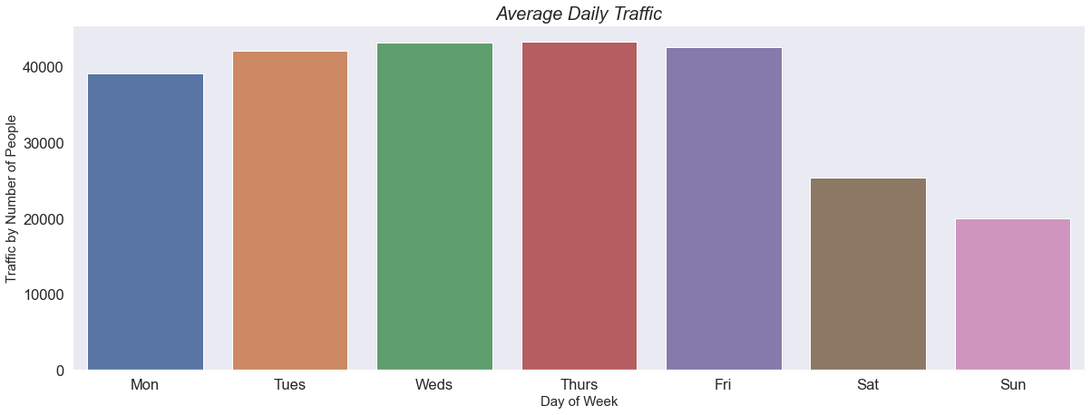
Appendix
2020 WomenTechWomenYes (WTWY) Annual Gala, NYC

